Slide 1
Project #48
Sunlink II: Light-Based Wireless Communication Using Sunlight
Presented by Ryan Farrell and Vivek Chauhan

Slide 2


Research Question
How can sun-tracking, light based communication systems be designed to provide reliable system-to-system data transmission using direct sunlight, while expanding on existing ambient light-based technologies?

Slide 3
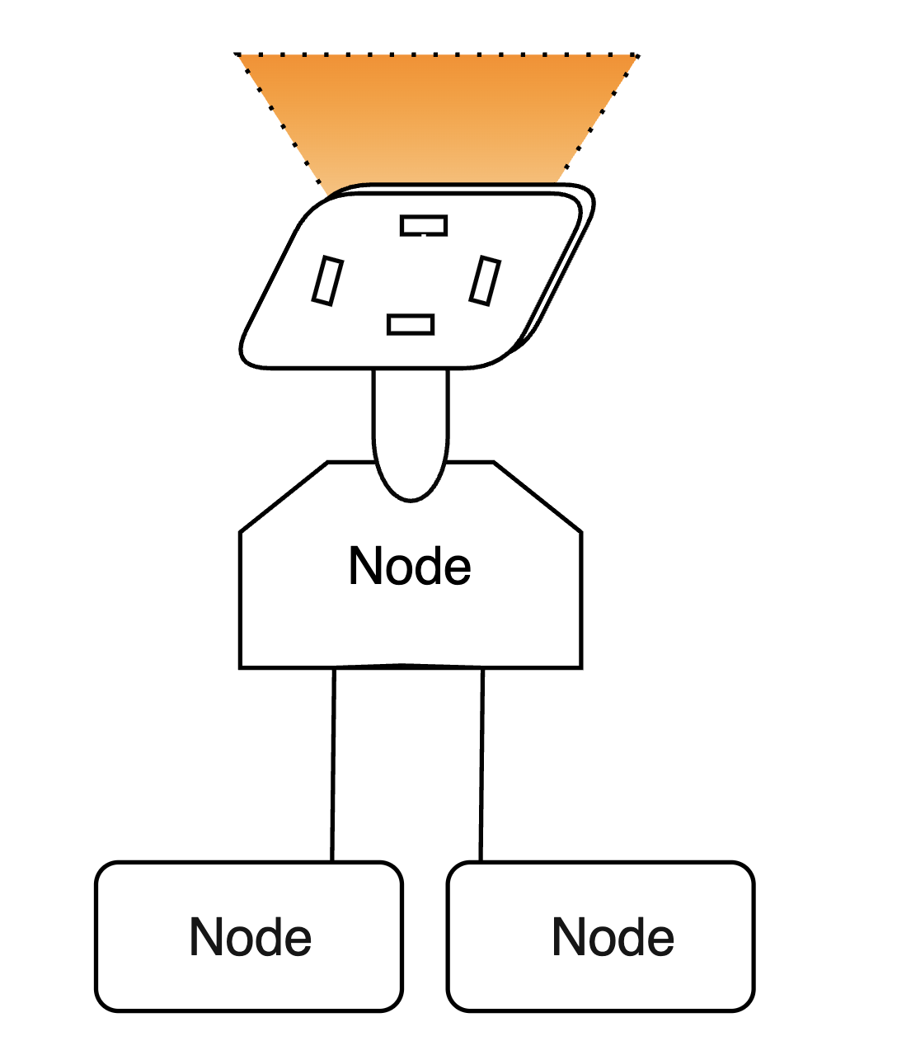
Project Introduction
What is Sunlink II ?
A passive, sunlight-based wireless communication system.
Motivation:
Avoid RF congestion, enabling low-power, remote sensing data links
Reliable VLC through Sun tracking and multi-node communication

Slide 4
System Architecture Overview
Sunlink II
Sun Tracking Subsystem
Multi-Nodal Subsystem

Slide 5
Sun- Tracking Subsystem

Slide 6

Sun tracking Problem & Requirements
Why is tracking is needed:
Sun light azimuth/elevation changes over time.
Maximising Optical Alignment Improving signal strength
Tracking range required:
Azimuth: ~180°
Elevation: ~0-90°

Slide 7

Mechanical System Design
Dual- axis pan-tilt platform
Stepper Motor + Driver for Azimuth & Elevation
Why a Stepper and Servo set-up?
Use of 3D printing for Mock Design, and frame to allow for modular component placement.

Slide 8
Sensor & Sun Detection
Sensor Array: - Hybrid Light Light Dependent Resistor (LDR) + Photodiode Design
Directional Error Logic: - Quadrant sensor layout for azimuth/ elevation correction
Liquid Crystal (LC) shutter modulator placed along light axis

Slide 9
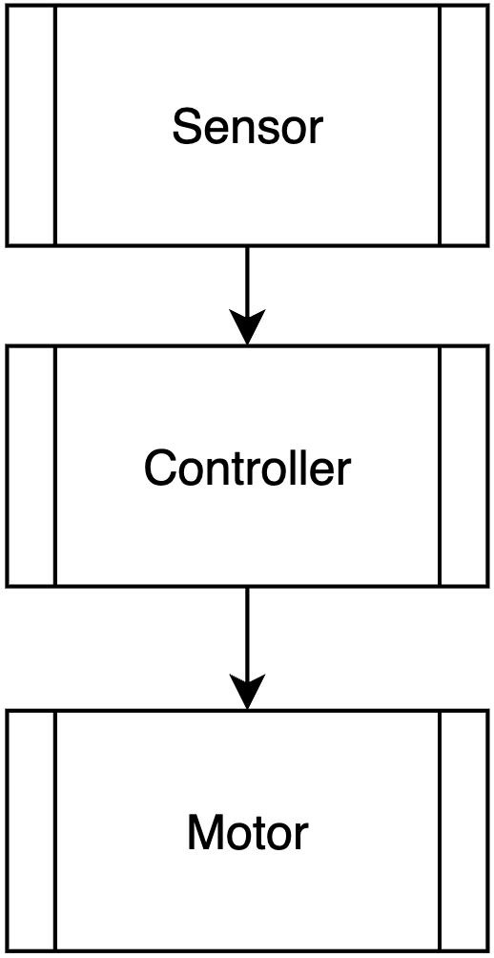

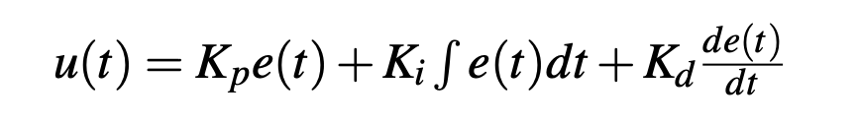

Control System Design (PID)
Proportional–Integral–Derivative controller:
Input : Light Imbalance Error Output : Stepper motor commands ( Step logic )
Microcontroller : MSP-430

Slide 10
Visible Light Communication

Slide 11
Ambient Light Backscattering
What is Ambient Light Backscattering (ALB)?
The idea of embedding data into existing ambient light
Why not Radio Frequency (RF)?
Passive transmission source -> Low power
No powerful transmitter required -> Cheaper
RF spectrum -> Clustered
Notes:
Talk about low power requirements because no active source (leveraging existing source)

Slide 12
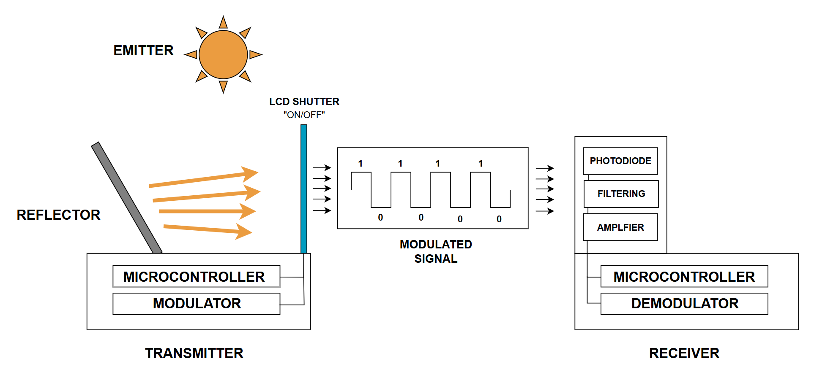
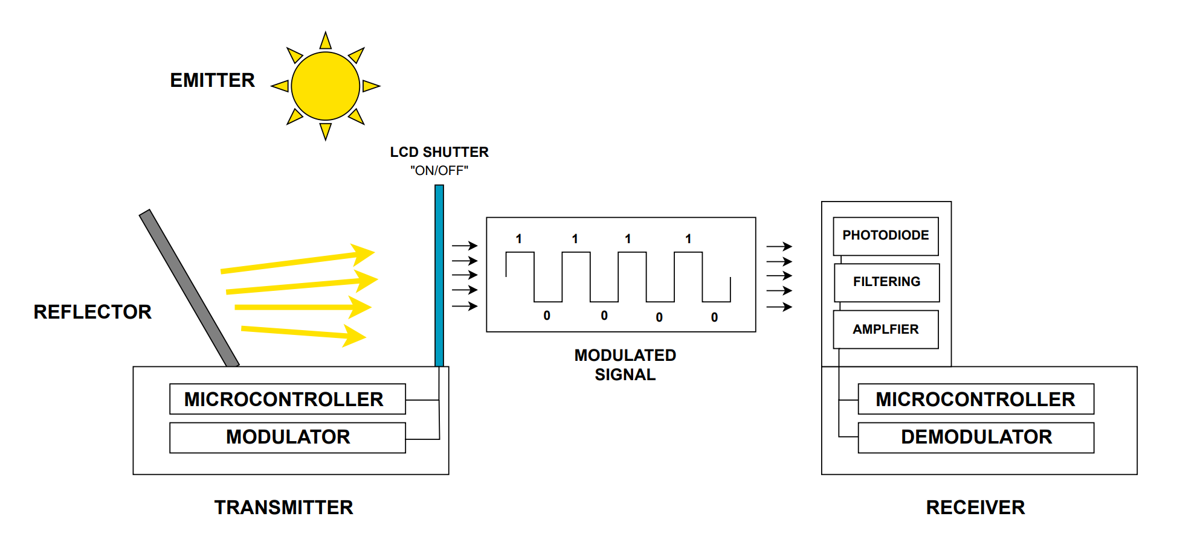
Ambient Light Backscattering
How are we utilising this technology?
Notes:
Talk about low power requirements because no active source (leveraging existing source)

Slide 13
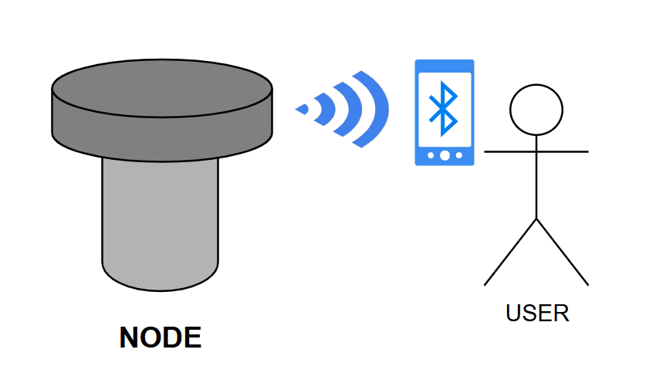
User Access and Interface
Each node has a Bluetooth module for local access
Users can connect to download the most recent message
This allows decentralised, resilient access - even if some nodes fail

Slide 14
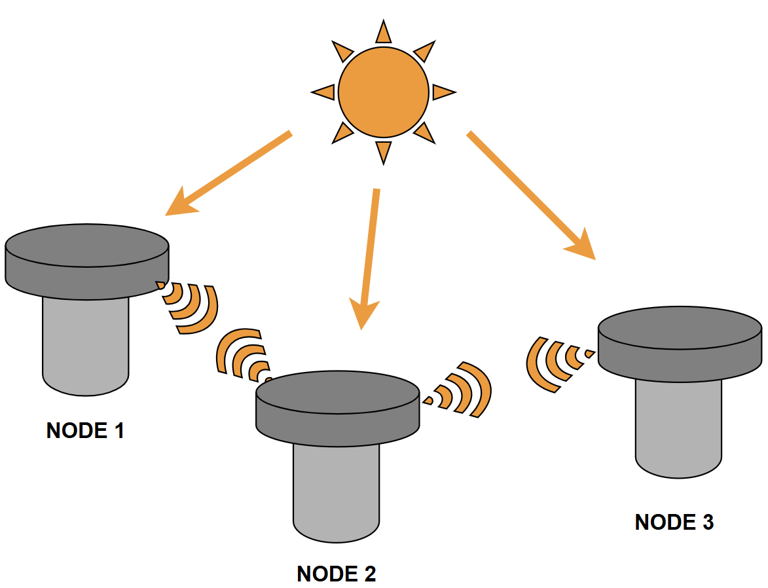
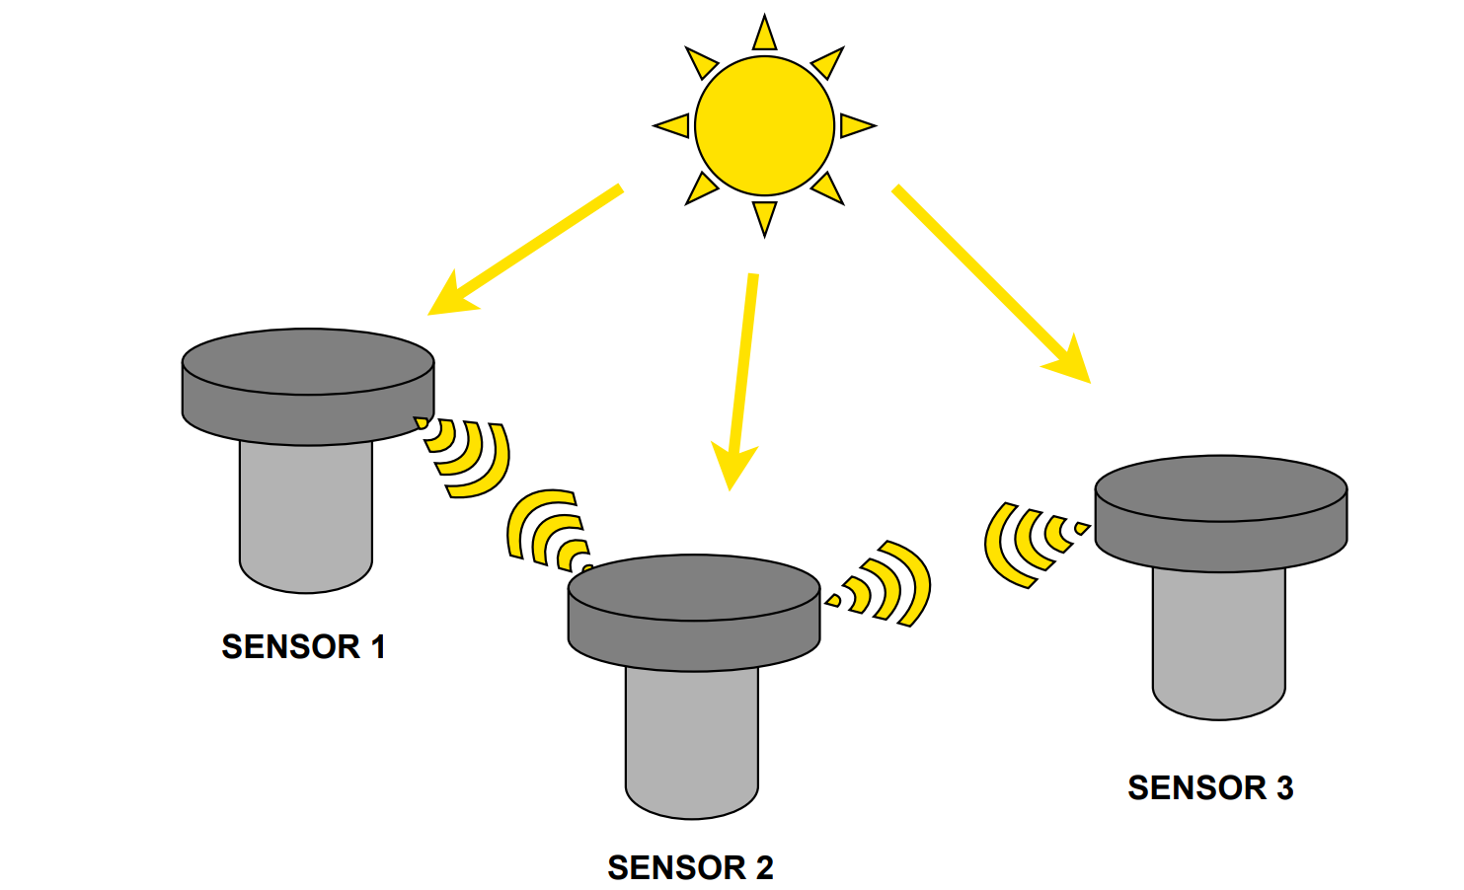
Multi-Nodal Communication
What is a multi-nodal communication system?

Slide 15
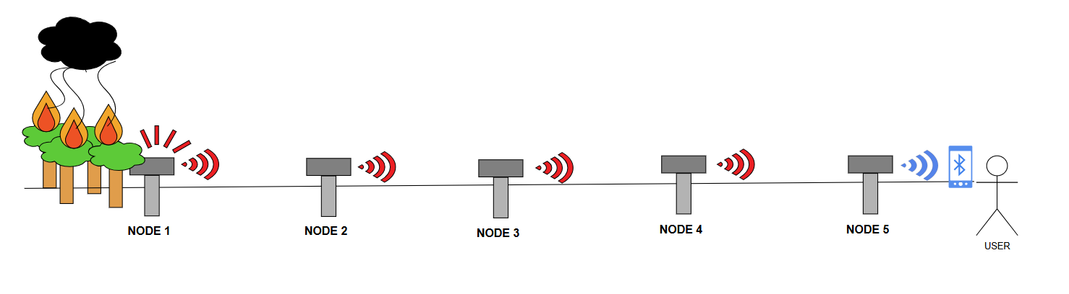
Multi-Nodal Communication
Motivation for multi-nodal system?
Any similar or existing platforms in research field?

Slide 16

Expected Challenges
Challenges
Sensor alignment for light paths
Ambient noise
Weather dependence

Slide 17
System Integration & Evaluation Strategies
Sun- Tracking Subsystem | Communication Subsystem
Accuracy | Range
Responsiveness | Message Accuracy
Angular Deviation | Variable Lighting

Slide 18
System Integration & Evaluation Strategies
FULL SYSTEM INTEGRATION
Power consumption
Range
Reliability under different lighting conditions

Slide 19
Conclusion
Bringing it All Together: A Low-Power, Light-Based Sensing Network
Low Power - For remote sensing applications
Sun Tracking - For maximised light signal strength
Multi-Node - Allows for a signal chain
Local Access - Decentralised, resilient access

Slide 20

Thank you for your attention!
Q&A

